Slide 1
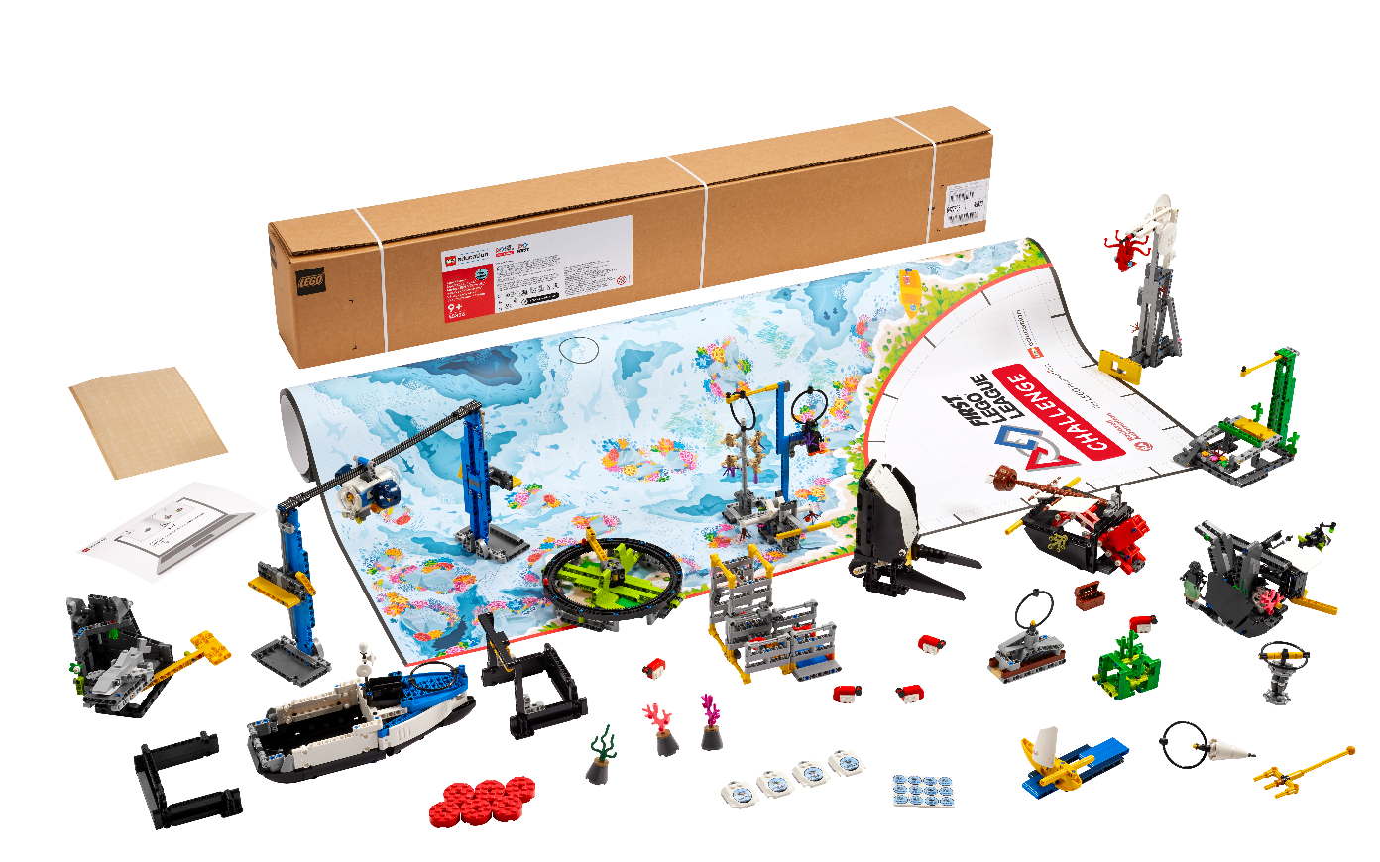


Session 12
Communicate Solutions
Notes:
Facilitator Tips –
Plan to split the time in this session equally between practicing the presentation and the robot game matches.
Encourage the team to practice their presentation before the event. They can practice by sharing their solution with others.
Have the team run their 2.5-minute robot matches. Make sure they practice running their programs in the right order.
The team should have a contingency plan for if things don’t go as planned during the robot game. They could identify other missions to run.
Remind the team about the Core Values and how they will show them throughout the event, including at every robot game match.

Slide 2

Session Overview
Outcomes
The team will practice their presentation of their innovation project and robot solutions.
The team will run practice robot game matches.
Notes:
Outcomes
The team will practice their presentation of their innovation project and robot solutions.
The team will run practice robot game matches.
Facilitator Tips –
Plan to split the time in this session equally between practicing the presentation and the robot game matches.
Encourage the team to practice their presentation before the event. They can practice by sharing their solution with others.
Have the team run their 2.5-minute robot matches. Make sure they practice running their programs in the right order.
The team should have a contingency plan for if things don’t go as planned during the robot game. They could identify other missions to run.
Remind the team about the Core Values and how they will show them throughout the event, including at every robot game match.

Slide 3
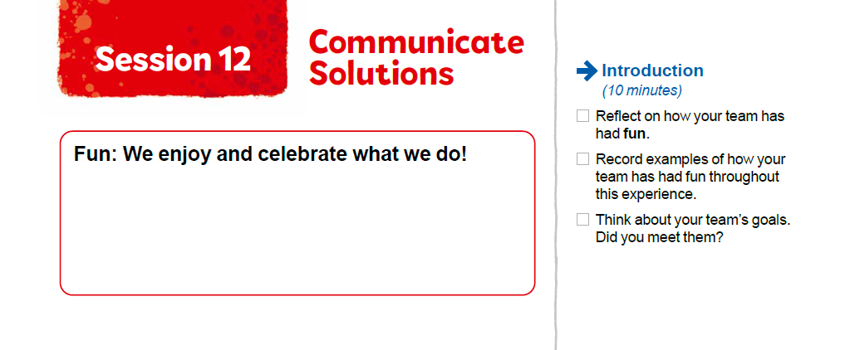


Introduction
Reflect on how your team has had fun.
Record examples of how your team has had fun throughout this experience.
Think about your team’s goals. Did you meet them?
Notes:
Introduction (10-15 minutes)
Outcomes
The team will practice their presentation of their innovation project and robot solutions.
The team will run practice robot game matches.
Facilitator Tips –
Plan to split the time in this session equally between practicing the presentation and the robot game matches.
Encourage the team to practice their presentation before the event. They can practice by sharing their solution with others.
Have the team run their 2.5-minute robot matches. Make sure they practice running their programs in the right order.
The team should have a contingency plan for if things don’t go as planned during the robot game. They could identify other missions to run.
Remind the team about the Core Values and how they will show them throughout the event, including at every robot game match.

Slide 4
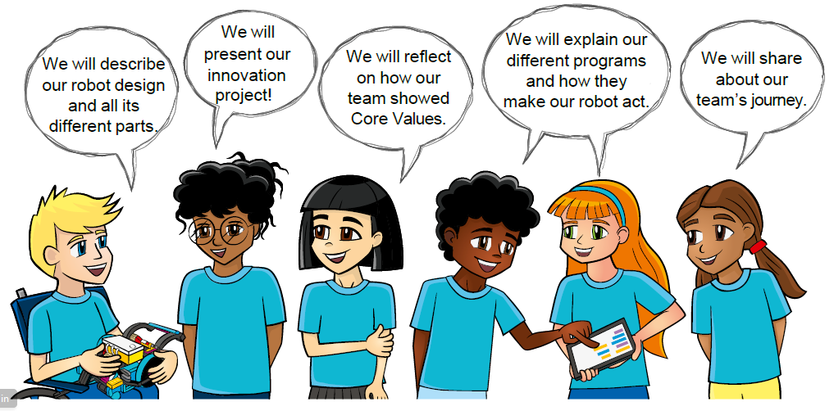
Practice
Rehearse your full presentation communicating your robot and Innovation Project solutions.
Demonstrate Core Values when you present!
Notes:
Team Tasks (100-120 minutes)
Outcomes
The team will practice their presentation of their innovation project and robot solutions.
The team will run practice robot game matches.
Facilitator Tips –
Plan to split the time in this session equally between practicing the presentation and the robot game matches.
Encourage the team to practice their presentation before the event. They can practice by sharing their solution with others.
Have the team run their 2.5-minute robot matches. Make sure they practice running their programs in the right order.
The team should have a contingency plan for if things don’t go as planned during the robot game. They could identify other missions to run.
Remind the team about the Core Values and how they will show them throughout the event, including at every robot game match.

Slide 5
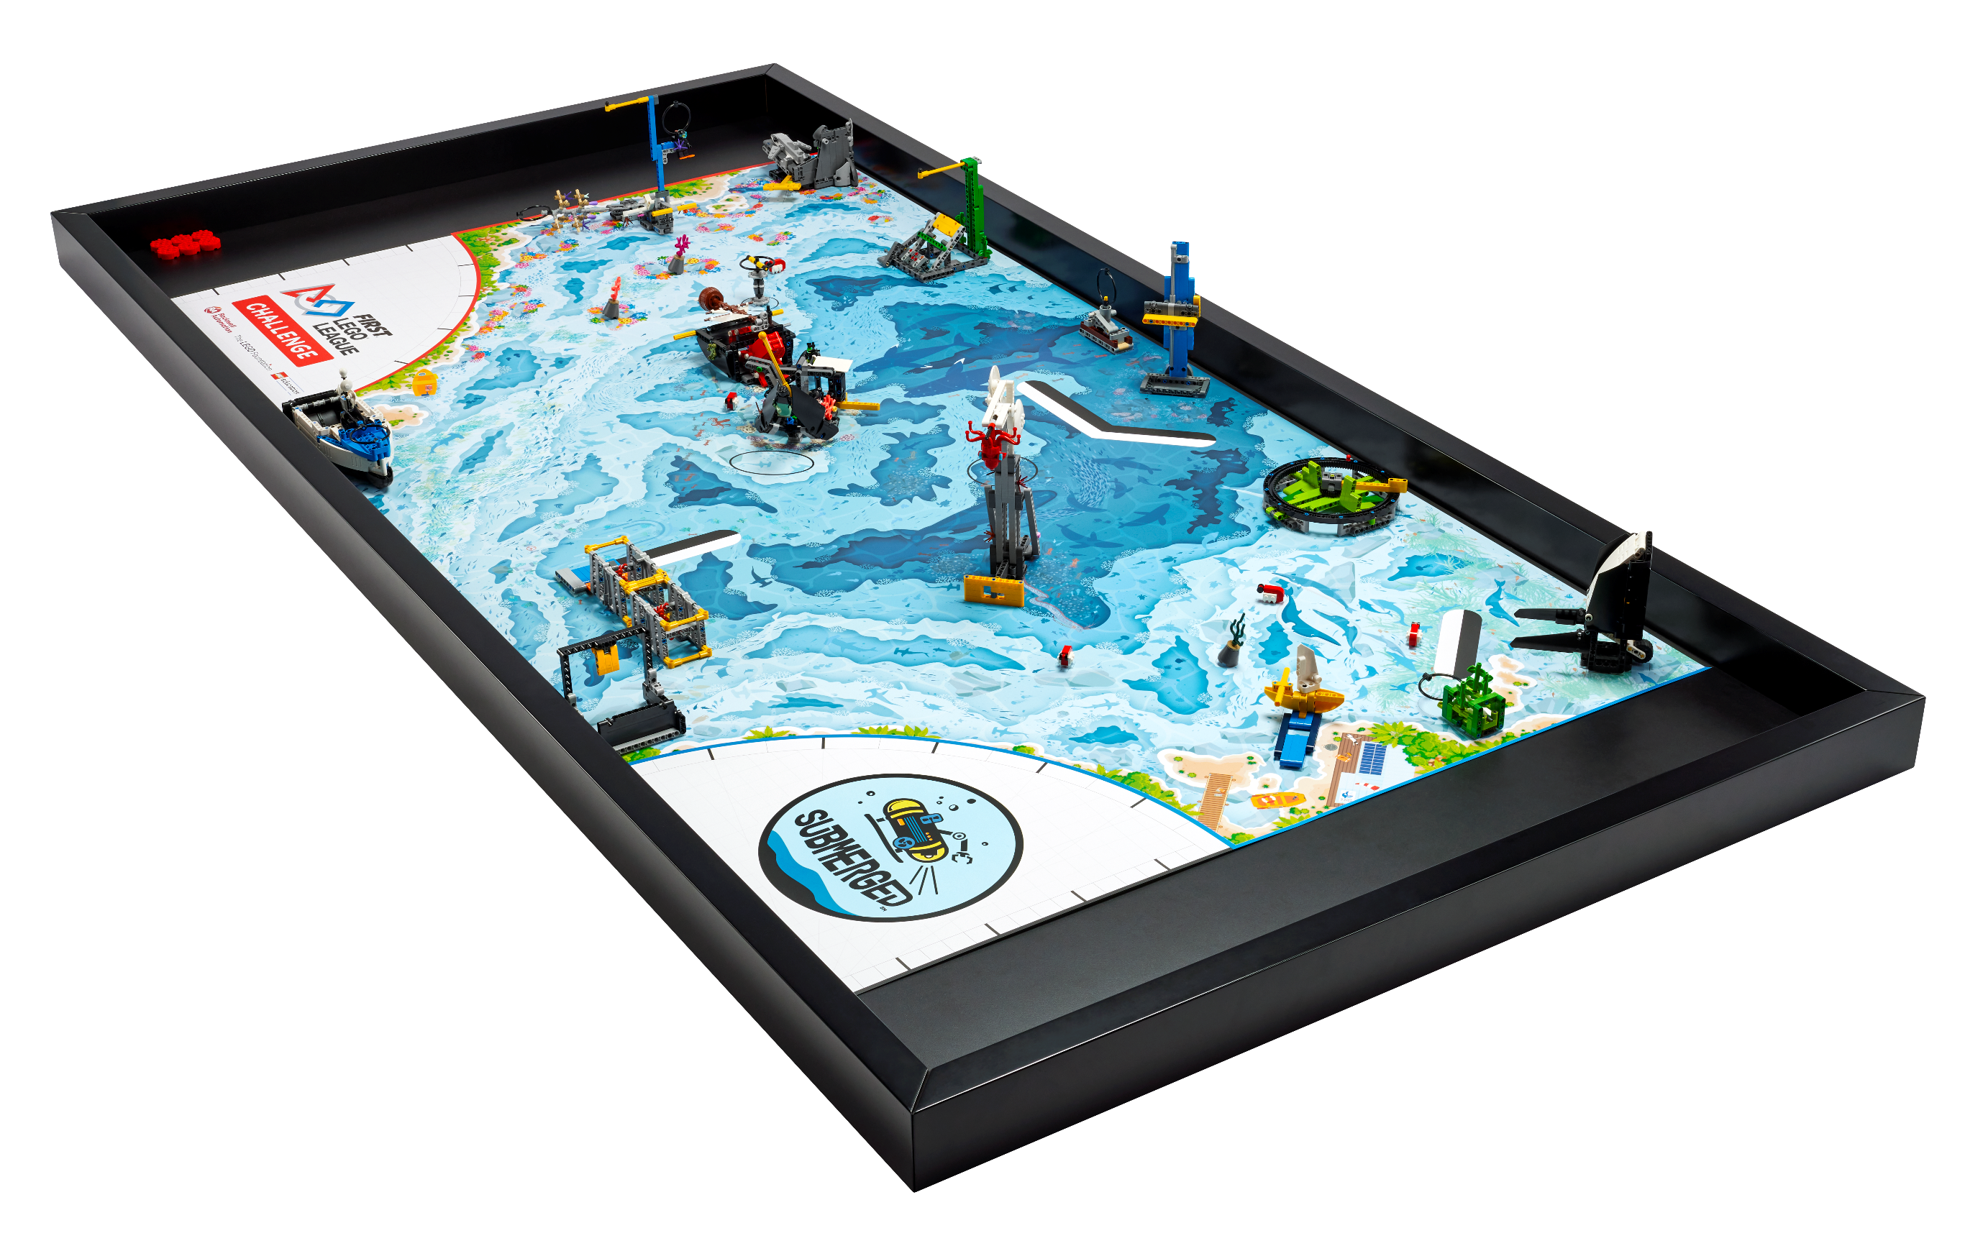
Practice
Demonstrate Core Values when you present!
Practice multiple 2.5-minute robot game matches.
Notes:
Team Tasks (100-120 minutes)
Facilitator Tips –
Plan to split the time in this session equally between practicing the presentation and the robot game matches.
Encourage the team to practice their presentation before the event. They can practice by sharing their solution with others.
Have the team run their 2.5-minute robot matches. Make sure they practice running their programs in the right order.
The team should have a contingency plan for if things don’t go as planned during the robot game. They could identify other missions to run.
Remind the team about the Core Values and how they will show them throughout the event, including at every robot game match.

Slide 6
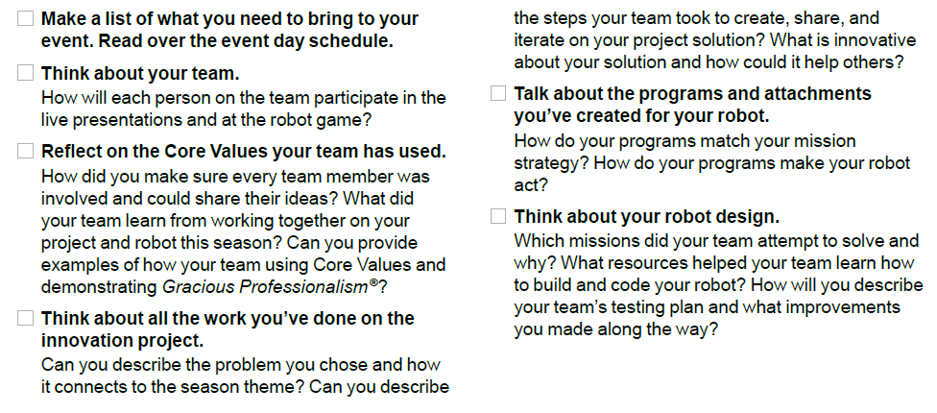
Practice
Review pages 32-33. Prepare for Your Event.
Notes:
Team Tasks (100-120 minutes)
Facilitator Tips –
Plan to split the time in this session equally between practicing the presentation and the robot game matches.
Encourage the team to practice their presentation before the event. They can practice by sharing their solution with others.
Have the team run their 2.5-minute robot matches. Make sure they practice running their programs in the right order.
The team should have a contingency plan for if things don’t go as planned during the robot game. They could identify other missions to run.
Remind the team about the Core Values and how they will show them throughout the event, including at every robot game match.

Slide 7
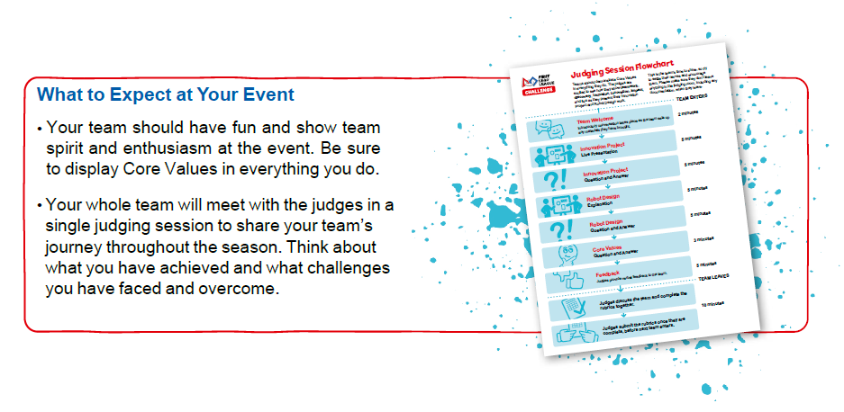
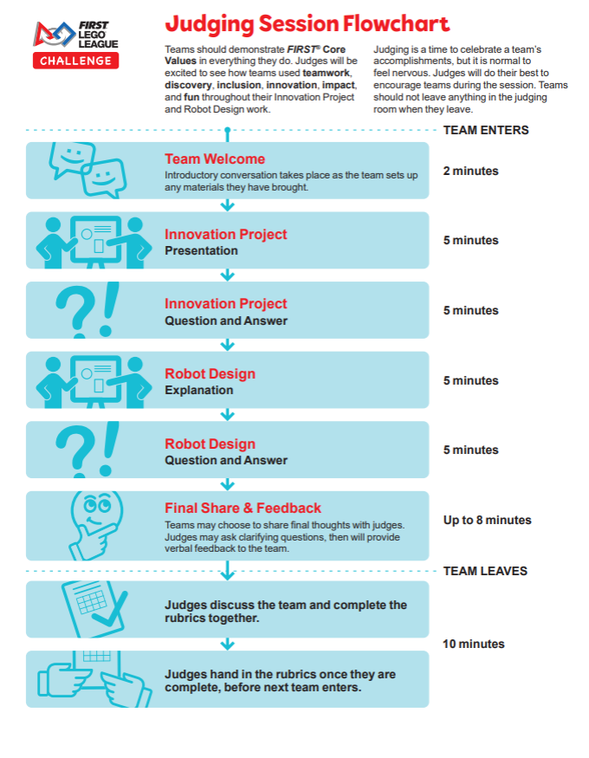
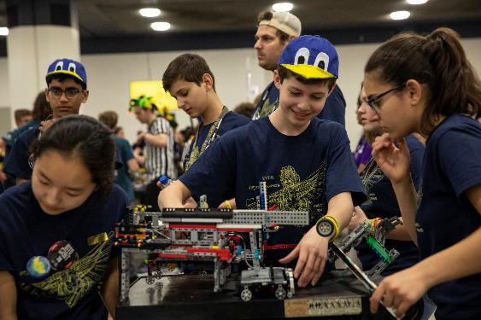
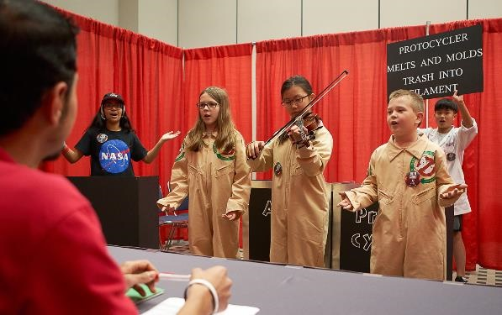
Notes:
Team Tasks (100-120 minutes)
Facilitator Tips –
Plan to split the time in this session equally between practicing the presentation and the robot game matches.
Encourage the team to practice their presentation before the event. They can practice by sharing their solution with others.
Have the team run their 2.5-minute robot matches. Make sure they practice running their programs in the right order.
The team should have a contingency plan for if things don’t go as planned during the robot game. They could identify other missions to run.
Remind the team about the Core Values and how they will show them throughout the event, including at every robot game match.

Slide 8
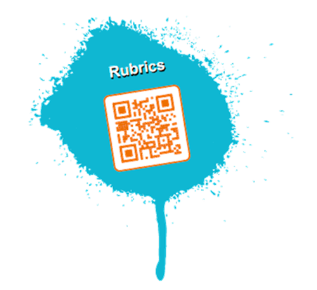

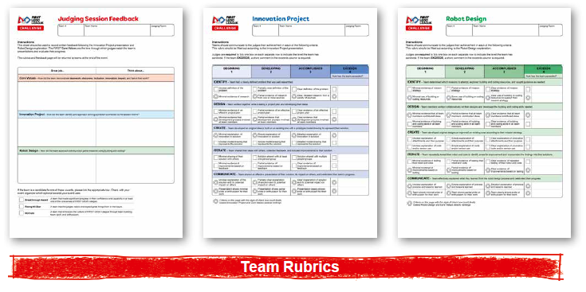
Prepare for Your Event
FIRST® LEGO® League is evaluated equally in four areas: Core Values, Innovation Project, Robot Design, and Robot Game. The judges and referees use the rubrics and Robot Game scoresheets to make this evaluation.
Notes:
Team Tasks (100-120 minutes)
Facilitator Tips –
Plan to split the time in this session equally between practicing the presentation and the robot game matches.
Encourage the team to practice their presentation before the event. They can practice by sharing their solution with others.
Have the team run their 2.5-minute robot matches. Make sure they practice running their programs in the right order.
The team should have a contingency plan for if things don’t go as planned during the robot game. They could identify other missions to run.
Remind the team about the Core Values and how they will show them throughout the event, including at every robot game match.

Slide 9

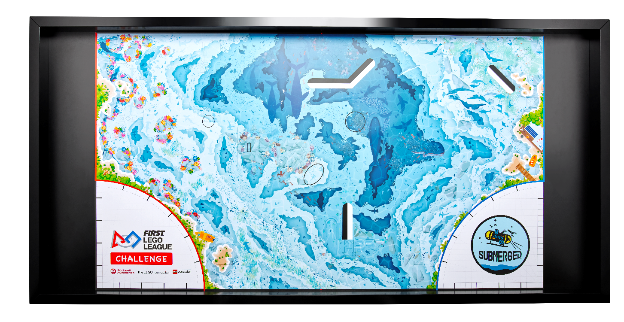
Prepare for Your Event
FIRST® LEGO® League teams express their Core Values through Gracious Professionalism®. This will be evaluated by referees for each team at every Robot Game match.
During the Robot Game, only some team members can be at the table during the 2.5-minute match. You can tag in other team members for different missions.
Notes:
Team Tasks (100-120 minutes)
Facilitator Tips –
Plan to split the time in this session equally between practicing the presentation and the robot game matches.
Encourage the team to practice their presentation before the event. They can practice by sharing their solution with others.
Have the team run their 2.5-minute robot matches. Make sure they practice running their programs in the right order.
The team should have a contingency plan for if things don’t go as planned during the robot game. They could identify other missions to run.
Remind the team about the Core Values and how they will show them throughout the event, including at every robot game match.

Slide 10
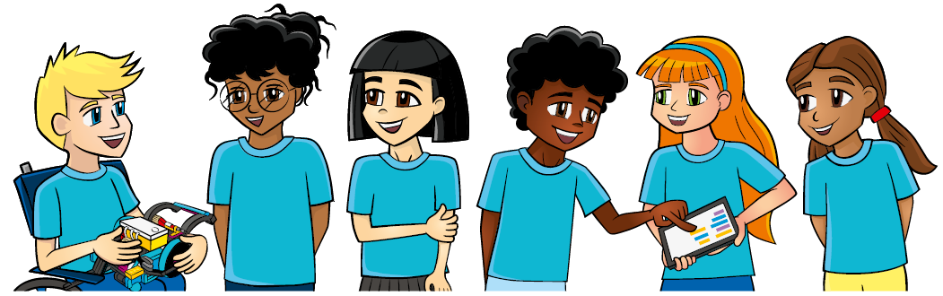
Share
Review the innovation project and robot design rubrics along with the robot game scoresheet.
Provide helpful feedback after the presentation to each other based on the rubrics.
Discuss the reflection questions.
Clean up your space.
Notes:
Share (10-15 minutes)
Facilitator Tips –
Plan to split the time in this session equally between practicing the presentation and the robot game matches.
Encourage the team to practice their presentation before the event. They can practice by sharing their solution with others.
Have the team run their 2.5-minute robot matches. Make sure they practice running their programs in the right order.
The team should have a contingency plan for if things don’t go as planned during the robot game. They could identify other missions to run.
Remind the team about the Core Values and how they will show them throughout the event, including at every robot game match.

Slide 11

Reflection Questions
What is your plan for having any LEGO® attachments built ready for the Robot Game?
Is everyone ready to speak clearly, smile, and have fun?
What has your team accomplished?
Notes:
Facilitator Tips –
Plan to split the time in this session equally between practicing the presentation and the robot game matches.
Encourage the team to practice their presentation before the event. They can practice by sharing their solution with others.
Have the team run their 2.5-minute robot matches. Make sure they practice running their programs in the right order.
The team should have a contingency plan for if things don’t go as planned during the robot game. They could identify other missions to run.
Remind the team about the Core Values and how they will show them throughout the event, including at every robot game match.

Slide 12

Multimedia Resources
You may wish to embed a relevant, age-appropriate video for your students here. See the Notes for an example.
Notes:
Choose a relevant, age-appropriate video for your students.
Example: The Tournament Experience https://youtu.be/E7XOzjeE7F8

Slide 13
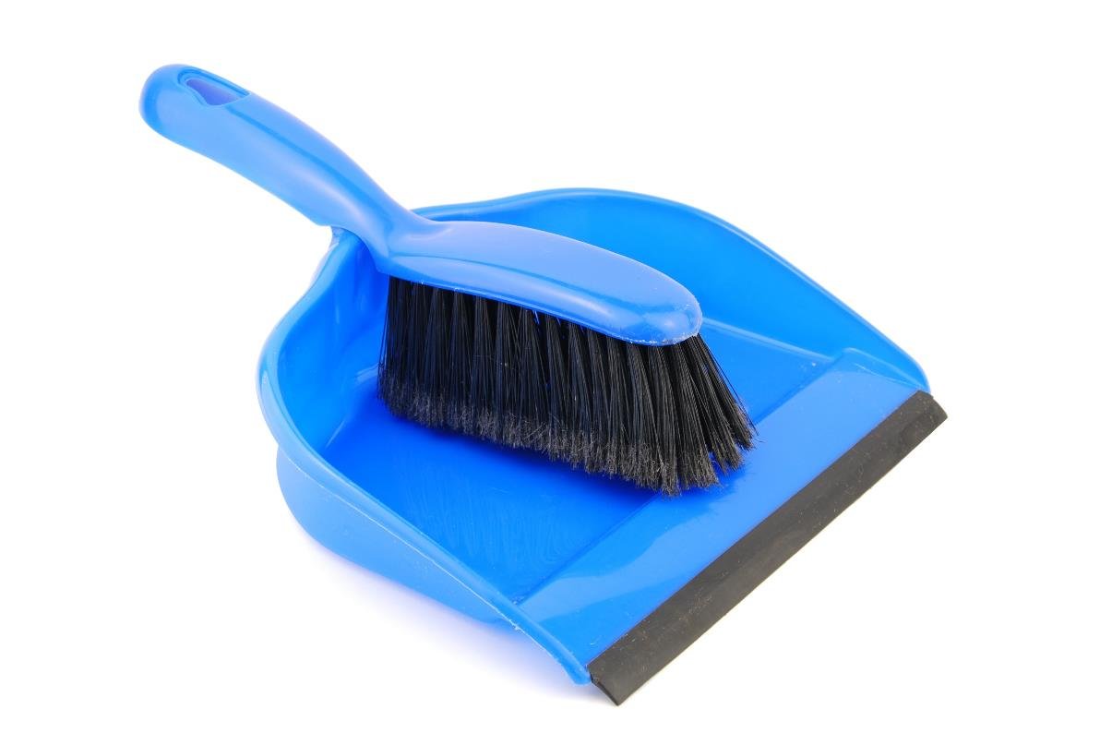
Clean Up
Notes:
Allow time for cleanup and place any unfinished models and their pieces in a sealed plastic bag.
Clean Up Pointers
You may wish to play a video or song during clean up time Link on
GoNoodle: https://family.gonoodle.com/activities/clean-up
Link on YouTube Kids: https://www.youtubekids.com/watch?v=ZJFk87ZsHn0
Link on Youtube: https://youtu.be/ZJFk87ZsHn0

Slide 14


LEGO, the LEGO logo, the SPIKE logo, MINDSTORMS and the MINDSTORMS logo are trademarks of the/sont des marques de commerce du/son marcas registradas de LEGO Group. ©2024 The LEGO Group. All rights reserved/Tous droits réservés/Todos los derechos reservados. FIRST ®, the FIRST ® logo, Coopertition ®, Gracious Professionalism®, and FIRST® DIVESM are trademarks of For Inspiration and Recognition of Science and Technology (FIRST). LEGO® is a registered trademark of the LEGO Group. FIRST® LEGO® League and SUBMERGEDSM are jointly held trademarks of FIRST and the LEGO Group. All other trademarks are the property of their respective owners. ©2024 FIRST and the LEGO Group. All rights reserved.

